Slide 1
Operating Systems
Virtual Memory - II

Slide 2
Swapping

Slide 3
Swap Space
Key idea: take frames from physical memory and swap (write) them to disk
This frees up space for other code and data
Load data from swap back into memory on-demand
If a process attempts to access a page that has been swapped out…
A page-fault occurs and the instruction pauses
The OS can swap the frame back in, insert it into the page table, and restart the instruction

Slide 4
Swapping Example
0xFFFF
Suppose memory is full
The user opens a new program
Swap out idle pages to disk
If the idle pages are accessed, page them back in
Kernel Memory
Active
Process 4
Process 5
Process 3
Active
Process 2
Active
Process 1
Hard
Drive
Idle
0x0000

Slide 5
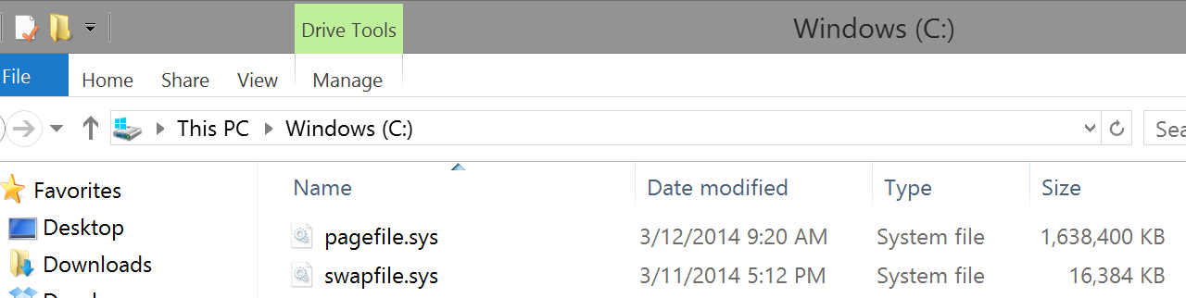
All Modern OSes Support Swapping
On Linux, you create a swap partition along with your normal ext3/4 filesystem
Swapped pages are stored in this separate partition
Windows

Slide 6
Implementing Swap
Data structures are needed to track the mapping between pages in memory and pages on disk
Meta-data about memory pages must be kept
When should pages be evicted (swapped to disk)?
How do you choose which page to evict?
The functionality of the OSes page fault handler must be modified

Slide 7
x86 Page Table Entry, Again
On x86, page table entries (PTE) are 4 bytes
31 - 12 | 11 - 9 | 8 | 7 | 6 | 5 | 4 | 3 | 2 | 1 | 0
Page Frame Number (PFN) | Unused | G | PAT | D | A | PCD | PWT | U/S | W | P
P – present bit – is this page in physical memory?
OS sets or clears the present bit based on its swapping decisions
1 means the page is in physical memory
0 means the page is valid, but has been swapped to disk
Attempts to access an invalid page or a page that isn’t present trigger a page fault

Slide 8
Handling Page Faults
Thus far, we have viewed page faults as bugs
i.e. when a process tries to access an invalid pointer
The OS kills the process that generate page faults
However, now handling page faults is more complicated
If the PTE is invalid, the OS still kills the process
If the PTE is valid, but present = 0, then
The OS swaps the page back into memory
The OS updates the PTE
The OS instructs the CPU to retry the last instruction

Slide 9
Page Fault Pseudocode
VPN = (VirtualAddress & VPN_MASK) >> SHIFT
(Success, TlbEntry) = TLB_Lookup(VPN)
if (Success == True) // TLB Hit
if (CanAccess(TlbEntry.ProtectBits) == True)
Offset = VirtualAddress & OFFSET_MASK
PhysAddr = (TlbEntry.PFN << SHIFT) | Offset
Register = AccessMemory(PhysAddr)
else RaiseException(PROTECTION_FAULT)
else // TLB Miss
PTEAddr = PTBR + (VPN * sizeof(PTE))
PTE = AccessMemory(PTEAddr)
if (PTE.Valid == False) RaiseException(SEGMENTATION_FAULT)
if (CanAccess(PTE.ProtectBits) == False)
RaiseException(PROTECTION_FAULT)
if (PTE.Present == True) // assuming hardware-managed TLB
TLB_Insert(VPN, PTE.PFN, PTE.ProtectBits)
RetryInstruction()
else if (PTE.Present == False) RaiseException(PAGE_FAULT)

Slide 10
When Should the OS Evict Pages?
Memory is finite, so when should pages be swapped?
On-demand approach
If a page needs to be created and no free pages exist, swap a page to disk
Proactive approach
Most OSes try to maintain a small pool of free pages
Implement a high watermark
Once physical memory utilization crosses the high watermark, a background process starts swapping out pages

Slide 11
What Pages Should be Evicted?
Known as the page-replacement policy
What is the optimal eviction strategy?
Evict the page that will be accessed furthest in the future
Provably results in the maximum cache hit rate
Unfortunately, impossible to implement in practice
Practical strategies for selecting which page to swap to disk
FIFO
Random
LRU (Least recently used)
Same fundamental algorithms as in TLB eviction

Slide 12
Examples of Optimal and LRU
Assume the cache can store 3 pages
Optimal (Furthest in the Future)
LRU
Access | Hit/Miss? | Evict | Cache State
0 | Miss |  | 0
1 | Miss |  | 0, 1
2 | Miss |  | 0, 1, 2
0 | Hit |  | 0, 1, 2
1 | Hit |  | 0, 1, 2
3 | Miss | 2 | 0, 1, 3
0 | Hit |  | 0, 1, 3
3 | Hit |  | 0, 1, 3
1 | Hit |  | 0, 1, 3
2 | Miss | 3 | 0, 1, 2
0 | Hit |  | 0, 1, 2
Access | Hit/Miss? | Evict | Cache State
0 | Miss |  | 0
1 | Miss |  | 0, 1
2 | Miss |  | 0, 1, 2
0 | Hit |  | 0, 1, 2
1 | Hit |  | 0, 1, 2
3 | Miss | 2 | 0, 1, 3
0 | Hit |  | 0, 1, 3
3 | Hit |  | 0, 1, 3
1 | Hit |  | 0, 1, 3
2 | Miss | 0 | 1, 2, 3
0 | Miss | 3 | 0, 1, 2

Slide 13
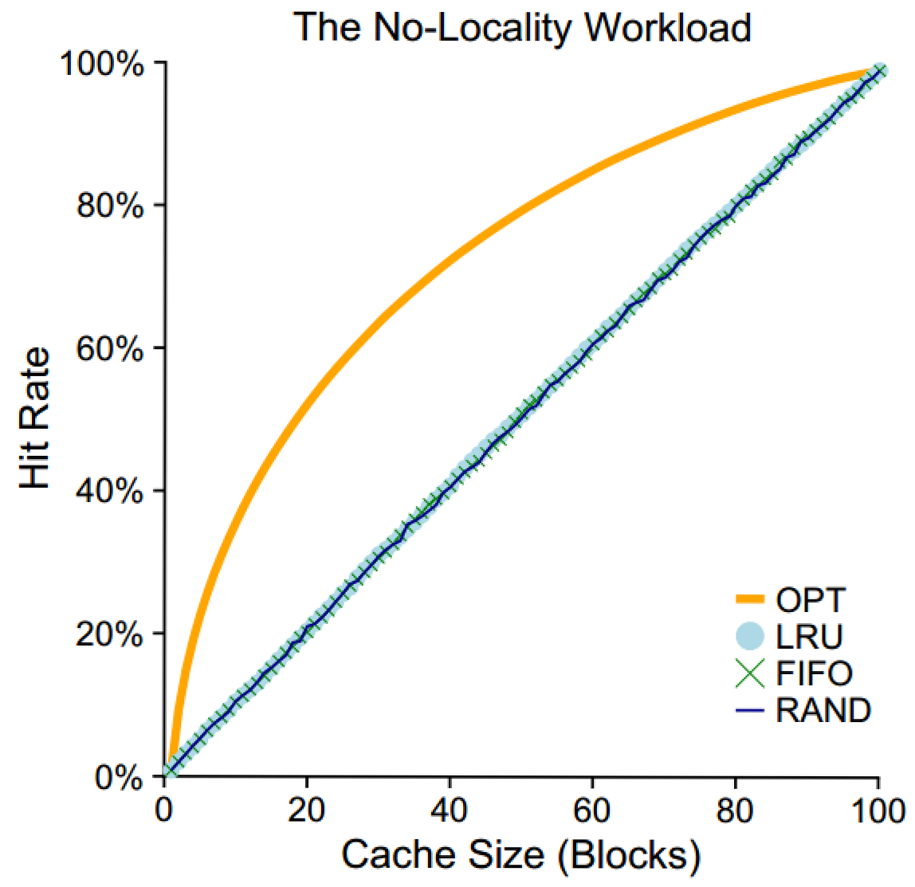
All memory accesses are to 100% random pages
When memory accesses are random, its impossible to be smart about caching

Slide 14
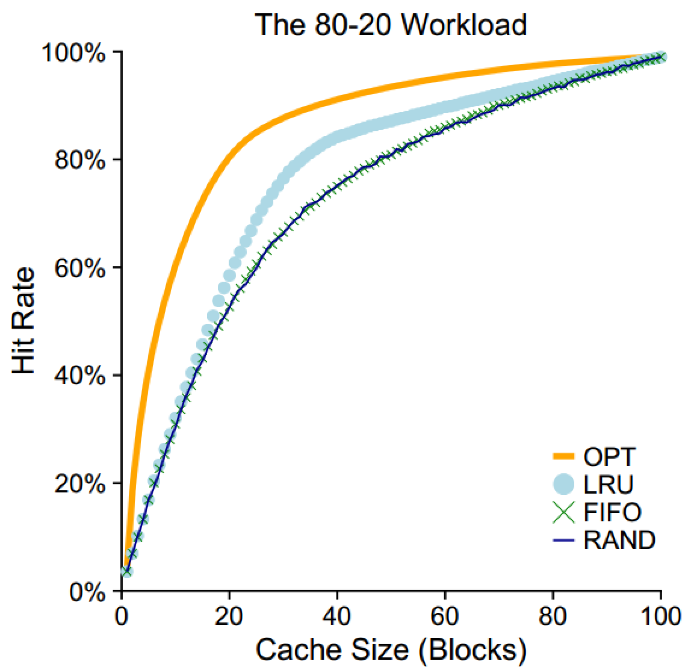
80% of memory accesses are for 20% of pages
LRU does a better job of keeping “hot” pages in RAM than FIFO or random

Slide 15
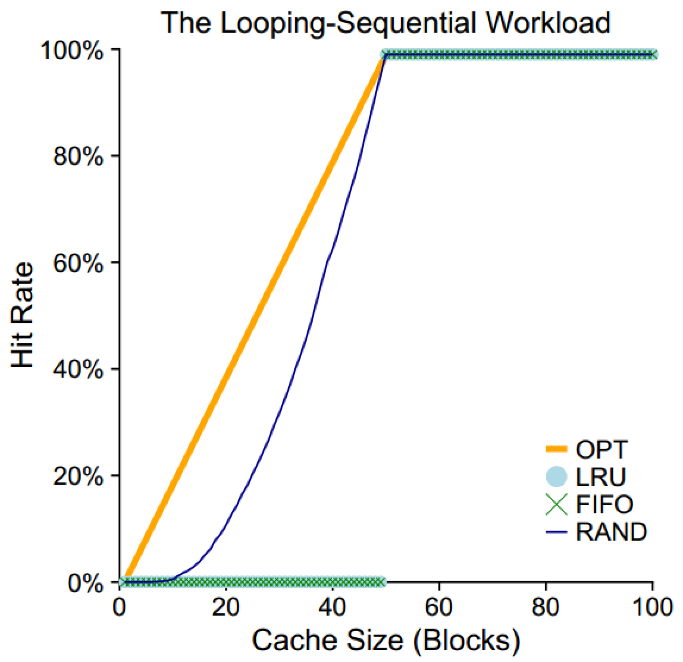
The process sequentially accesses one memory address in 50 pages, then loops
When C >= 50, all pages are cached, thus hit rate = 100%
When the cache size is C < 50, LRU evicts page X when page X + C is read
Thus, pages are not in the cache during the next iteration of the loop

Slide 16
Implementing Historical Algorithms
LRU has high cache hit rates in most cases…
… but how do we know which pages have been recently used?
Strategy 1: record each access to the page table
Problem: adds additional overhead to page table lookups
Strategy 2: approximate LRU with help from the hardware

Slide 17
x86 Page Table Entry, Again
On x86, page table entries (PTE) are 4 bytes
31 - 12 | 11 - 9 | 8 | 7 | 6 | 5 | 4 | 3 | 2 | 1 | 0
Page Frame Number (PFN) | Unused | G | PAT | D | A | PCD | PWT | U/S | W | P
Bits related to swapping
A – accessed bit – has this page been read recently?
D – dirty bit – has this page been written recently?
The MMU sets the accessed bit when it reads a PTE
The MMU sets the dirty bit when it writes to the page referenced in the PTE
The OS may clear these flags as it wishes

Slide 18
Approximating LRU
The accessed and dirty bits tell us which pages have been recently accessed
But, LRU is still difficult to implement
On eviction, LRU needs to scan all PTEs to determine which have not been used
But there are millions of PTEs!
Is there a clever way to approximate LRU without scanning all PTEs?
Yes!

Slide 19
The Clock Algorithm
Imagine that all PTEs are arranged in a circular list
The clock hand points to some PTE P in the list
function clock_algo() {
start = P;
do {
if (P.accessed == 0) {
evict(P);
return;
}
P.accessed = 0;
P = P.next;
} while (P != start);
evict_random_page();
}

Slide 20
Incorporating the Dirty Bit
More modern page eviction algorithms also take the dirty bit into account
For example: suppose you must evict a page, and all pages have been accessed
Some pages are read-only (like code)
Some pages have been written too (i.e. they are dirty)
Evict the non-dirty pages first
In some cases, you don’t have to swap them to disk!
Example: code is already on the disk, simply reload it
Dirty pages must always be written to disk
Thus, they are more expensive to swap

Slide 21
RAM as a Cache
RAM can be viewed as a high-speed cache for your large-but-slow spinning disk storage
You have GB of programs and data
Only a subset can fit in RAM at any given time
Ideally, you want the most important things to be resident in the cache (RAM)
Code/data that become less important can be evicted back to the disk

